Slide 1
I/O Hardware (W. Stallings, ch-11)
Notes:
These slides are intended to help a teacher develop a presentation. This PowerPoint covers the entire chapter and includes too many slides for a single delivery. Professors are encouraged to adapt this presentation in ways which are best suited for their students and environment.

Slide 2
Roadmap
I/O Devices
Device Controllers
Techniques for performing I/O
DMA
Principles of I/O
Notes:
Beginning with a brief discussion of I/O devices and the organization of the I/O functions.
Next examine operating system design issues, including design objectives, and the way in which the I/O function can be structured.
Then I/O buffering is examined;
The next sections of the chapter are devoted to magnetic disk I/O.
We begin by developing a model of disk I/O performance and then examine several techniques that can be used to enhance performance.

Slide 3
Categories of I/O Devices
Difficult area of OS design
Difficult to develop a consistent solution due to a wide variety of devices and applications
Three Categories:
Human readable
Machine readable
Communications

Slide 4
Human readable
Devices used to communicate with the user
Printers and terminals
Video display
Keyboard
Mouse etc
Notes:
Suitable for communicating with the computer user.
Examples include printers and terminals, the latter consisting of video display, keyboard, and perhaps other devices such as a mouse.

Slide 5
Machine readable
Used to communicate with electronic equipment
Disk drives
USB keys
Sensors
Controllers
Actuators
Notes:
Suitable for communicating with electronic equipment.
Examples are disk drives, USB keys, sensors, controllers, and actuators.

Slide 6
Communication
Used to communicate with remote devices
Digital line drivers
Modems
Notes:
Suitable for communicating with remote devices.
Examples are digital line drivers and modems.

Slide 7
Differences in I/O Devices
Devices differ in a number of areas
Data Rate
Application
Complexity of Control
Unit of Transfer
Data Representation (data encoding schemes)
Error Conditions
Notes:
Each of these are covered in subsequent slides
This diversity makes a uniform and consistent approach to I/O, both from the point of view of the operating system and from the point of view of user processes, difficult to achieve.

Slide 8
Roadmap
I/O Devices
Device Controllers
Techniques for performing I/O
DMA
Principles of I/O
Notes:
Beginning with a brief discussion of I/O devices and the organization of the I/O functions.
Next examine operating system design issues, including design objectives, and the way in which the I/O function can be structured.
Then I/O buffering is examined;
The next sections of the chapter are devoted to magnetic disk I/O.
We begin by developing a model of disk I/O performance and then examine several techniques that can be used to enhance performance.

Slide 9
Device Controllers
Device controller is a hardware unit attached to the I/O bus of the computer and works like an interface between a device and a device driver.
It is an electronic component consisting of chips that is responsible for handling the incoming and outgoing signals of the CPU.
It acts as a bridge between the device and the operating system which receives commands from the OS, such as read, write or more complex commands.
Each device controller has its own set of commands, depending on the nature or the manufacturer. So, there is different software running as part of the OS that interacts with each controller.
Thus, there is always a device controller and a device driver associated with each device that communicates with the OS. The controller receives the data from a connected device, stores it temporarily, and then communicates the data to its device driver. So, the device controller interacts with the OS via the device driver.

Slide 10
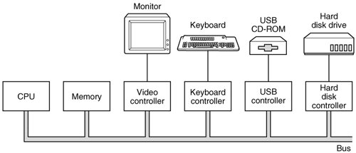
A model for connecting the CPU, memory, controllers, and I/O devices.

Slide 11
Roadmap
I/O Devices
Device Controllers
Techniques for performing I/O
DMA
Principles of I/O
Notes:
Beginning with a brief discussion of I/O devices and the organization of the I/O functions.
Next examine operating system design issues, including design objectives, and the way in which the I/O function can be structured.
Then I/O buffering is examined;
The next sections of the chapter are devoted to magnetic disk I/O.
We begin by developing a model of disk I/O performance and then examine several techniques that can be used to enhance performance.

Slide 12
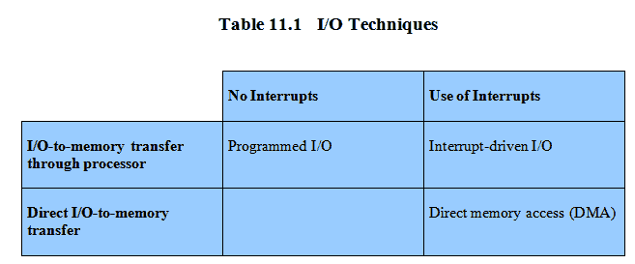
Techniques for performing I/O
Programmed I/O
Interrupt-driven I/O
Direct memory access (DMA)
Notes:
From section 1.7
Programmed I/O:
Processor issues an I/O command, on behalf of a process, to an I/O module;
that process then busy waits for the operation to be completed before proceeding.
Interrupt-driven I/O:
Processor issues an I/O command on behalf of a process.
If the I/O instruction from the process is nonblocking, then the processor continues to execute instructions from the process that issued the I/O command.
If the I/O instruction is blocking, then the next instruction that the processor executes is from the OS, which will put the current process in a blocked state and schedule another process.
Direct memory access (DMA):
A DMA module controls the exchange of data between main memory and an I/O module.
The processor sends a request for the transfer of a block of data to the DMA module and is interrupted only after the entire block has been transferred.
Table 11.1 indicates the relationship among these three techniques.

Slide 13
Evolution of the I/O Function
Processor directly controls a peripheral device
Controller or I/O module is added
Processor uses programmed I/O without interrupts
Processor does not need to handle details of external devices
Notes:
The processor directly controls a peripheral device.
This is seen in simple microprocessor-controlled devices.
A controller or I/O module is added.
The processor uses programmed I/O without interrupts.
With this step, the processor becomes somewhat divorced from the specific details of external device interfaces.

Slide 14
Evolution of the I/O Function cont…
Controller or I/O module with interrupts
Efficiency improves as processor does not spend time waiting for an I/O operation to be performed
Direct Memory Access
Blocks of data are moved into memory without involving the processor
Processor involved at beginning and end only
Notes:
3. Now interrupts are employed.
The processor need not spend time waiting for an I/O operation to be performed, thus increasing efficiency.
4. The I/O module is given direct control of memory via DMA.
It can now move a block of data to or from memory without involving the processor, except at the beginning and end of the transfer.

Slide 15
Evolution of the I/O Function cont…
I/O module is a separate processor
CPU directs the I/O processor to execute an I/O program in main memory.
I/O processor
I/O module has its own local memory
Commonly used to control communications with interactive terminals
Notes:
5. I/O module is enhanced to become a separate processor, with a specialized instruction set tailored for I/O.
CPU directs the I/O processor to execute an I/O program in main memory.
The I/O processor fetches and executes these instructions without processor intervention.
Allowing the processor to specify a sequence of I/O activities and to be interrupted only when the entire sequence has been performed.
6. The I/O module has a local memory of its own and is, in fact, a computer in its own right.
A large set of I/O devices can be controlled, with minimal processor involvement.
Commonly used to control communications with interactive terminals. The I/O processor takes care of most of the tasks involved in controlling the terminals.

Slide 16
Roadmap
I/O Devices
Device Controllers
Techniques for performing I/O
DMA
Principles of I/O
Notes:
Beginning with a brief discussion of I/O devices and the organization of the I/O functions.
Next examine operating system design issues, including design objectives, and the way in which the I/O function can be structured.
Then I/O buffering is examined;
The next sections of the chapter are devoted to magnetic disk I/O.
We begin by developing a model of disk I/O performance and then examine several techniques that can be used to enhance performance.

Slide 17
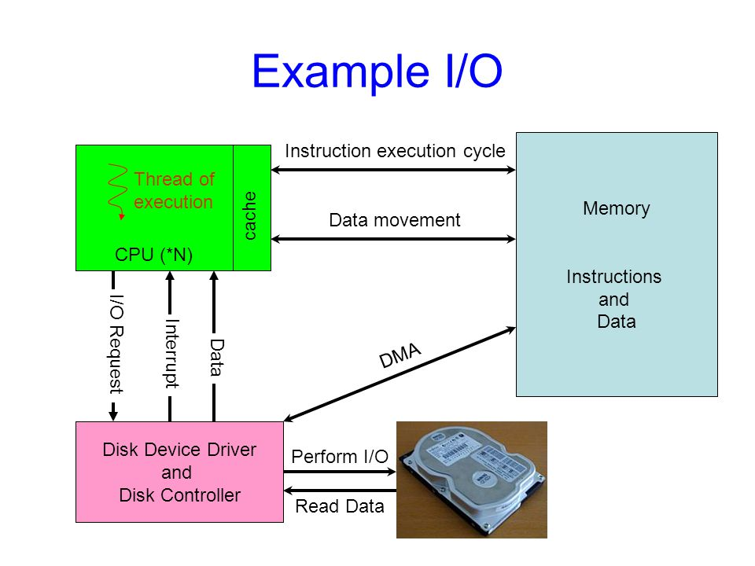

Slide 18
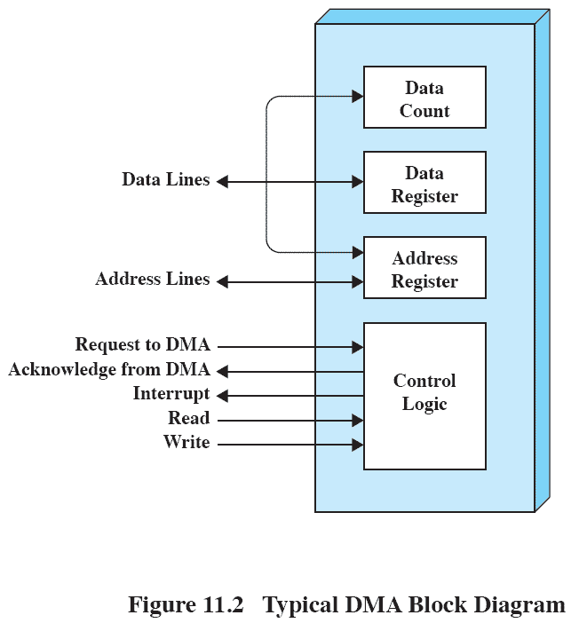
Direct Memory Address
Processor delegates I/O operation to the DMA module
DMA module transfers data directly to or form memory
When complete DMA module sends an interrupt signal to the processor
You may refer to following link for more details:
https://flylib.com/books/en/3.275.1.27/1/

Slide 19
Roadmap
I/O Devices
Device Controllers
Techniques for performing I/O
DMA
Principles of I/O
Notes:
Beginning with a brief discussion of I/O devices and the organization of the I/O functions.
Next examine operating system design issues, including design objectives, and the way in which the I/O function can be structured.
Then I/O buffering is examined;
The next sections of the chapter are devoted to magnetic disk I/O.
We begin by developing a model of disk I/O performance and then examine several techniques that can be used to enhance performance.

Slide 20
Goals: Efficiency
Most I/O devices extremely slow compared to main memory
Use of multiprogramming allows for some processes to be waiting on I/O while another process executes
I/O cannot keep up with processor speed
Swapping used to bring in ready processes
But this is an I/O operation itself
Notes:
Efficiency is important because I/O operations often form a bottleneck in a computing system.
One way to tackle this problem is multiprogramming, which, as we have seen, allows some processes to be waiting on I/O operations while another process is executing.
However, even with the vast size of main memory in today’s machines, often I/O is not keeping up with the activities of the processor.
Swapping is used to bring in additional ready processes to keep the processor busy, but this in itself is an I/O operation.
Thus, a major effort in I/O design has been schemes for improving the efficiency of the I/O.
The area that has received the most attention, because of its importance, is disk I/O.

Slide 21
Generality
For simplicity and freedom from error it is desirable to handle all I/O devices in a uniform manner
Hide most of the details of device I/O in lower-level routines
Difficult to completely generalize, but can use a hierarchical modular design of I/O functions
Notes:
For simplicity and freedom from error, it is desirable to handle all devices in a uniform manner.
This applies both to the way in which processes view I/O devices and the way in which the operating system manages I/O devices and operations.
Because of the diversity of device characteristics, it is difficult in practice to achieve true generality.
What can be done is to use a hierarchical, modular approach to the design of the I/O function.
T his hides most of the details of device I/O in lower-level routines so that user processes and upper levels of the operating system see devices in terms of general functions, such as read, write, open, close, lock, unlock.

Slide 22
Hierarchical design
A hierarchical philosophy leads to organizing an OS into layers
Each layer relies on the next lower layer to perform more primitive functions
It provides services to the next higher layer.
Changes in one layer should not require changes in other layers
Notes:
The hierarchical philosophy developed in Chapter 2 suggested that the functions of the operating system should be separated according to their complexity, their characteristic time scale, and their level of abstraction.
This approach leads to an organization of the operating system into a series of layers.
Each layer performs a related subset of the functions required of the operating system.
It relies on the next lower layer to perform more primitive functions and to conceal the details of those functions.
It provides services to the next higher layer.
Ideally, the layers should be defined so that changes in one layer do not require changes in other layers.

